Slide 1
Intro to Neural Nets
Attention & Transformers

Slide 2

Today’s Agenda
Attention Mechanism in RNNs for Translation (2014)
Sequence to sequence models with attention in translation tasks.
More General, Approach (No RNNs Required)
We can hard-code a measure of semantic similarity between a focal token, and all other tokens in the sequence
QKV Framework & Multi-head Attention
We can incorporate trainable weights around the attention mechanism.

Slide 3
TF-IDF is “Static Attention”
Not all phrases are of equal importance…
E.g., David less important than Beckham
If a term occurs all the time, observing its presence is less informative
Inverse-document frequency (IDF) helps address this.
Term ‘weighting’ is then calculated as Term Frequency (TF) x IDF
n_{j}= # of docs containing the term, N = total # of docs
A term is deemed important if it has a high TF and/or a high IDF.
As TF goes up, the word is more common generally. As IDF goes up, it means very few documents contain this term.

Slide 4
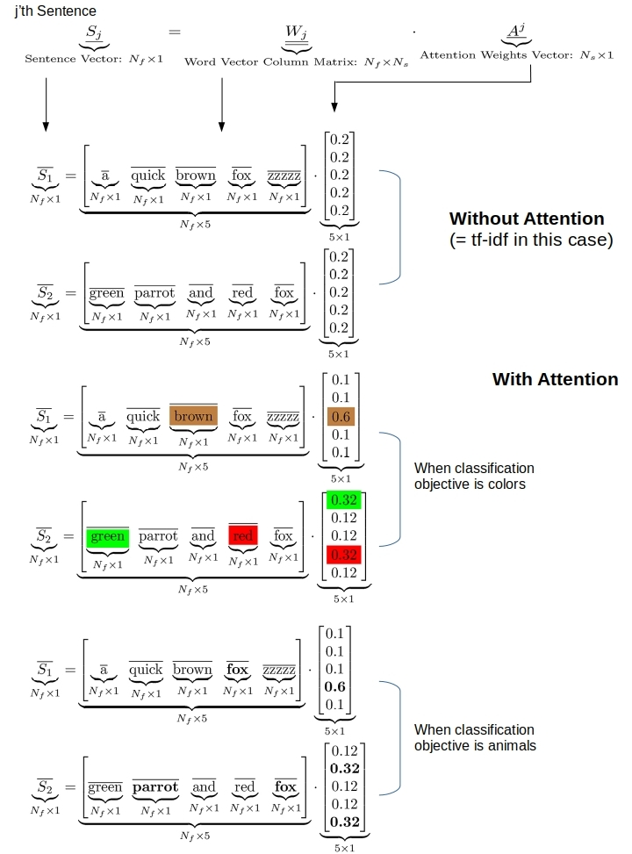
What Would Adaptive Weights Look Like?
Figure Out Weights Useful for Prediction
Rather than telling the network the weights, which is what TF-IDF effectively does, we provide the network a weight matrix to update!
This Yields Task-specific Token Weights
See some simple examples on the right.
Our network may learn that certain tokens are more important for predicting a given label.

Slide 5
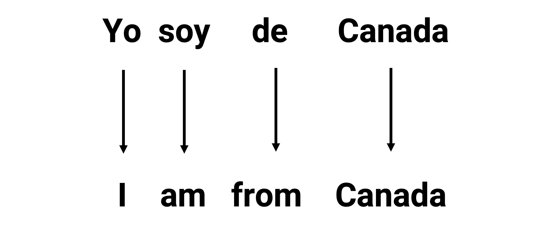
Where Attention Came From: Sequence-to-Sequence Models

Slide 6
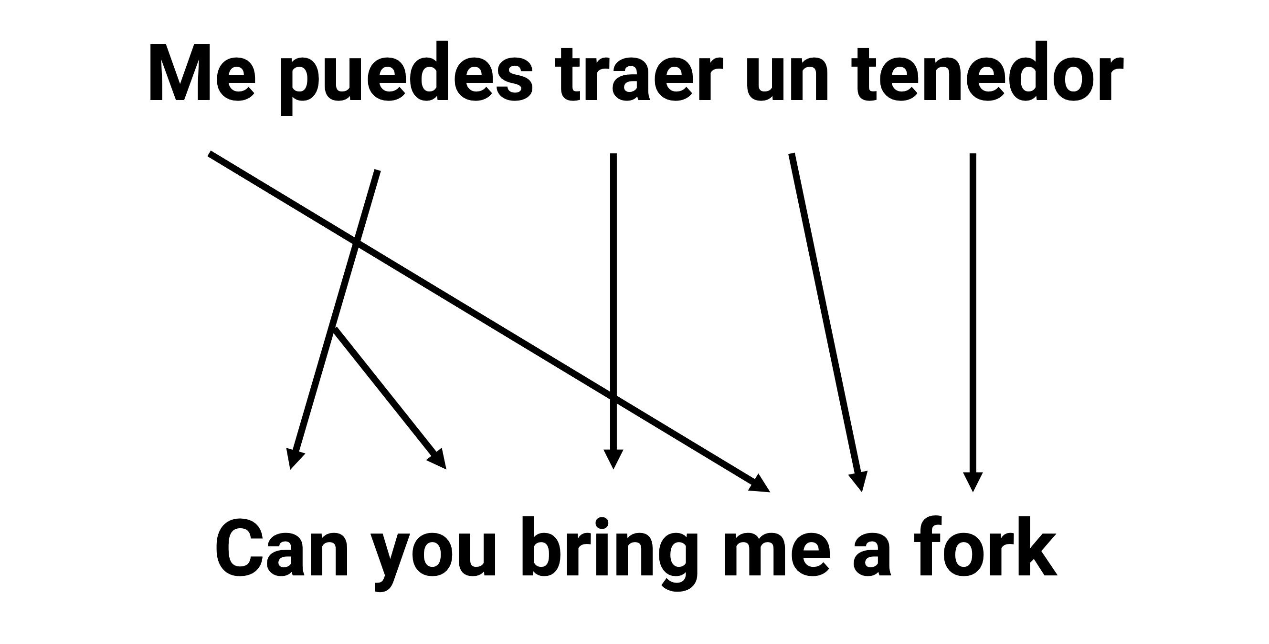
Struggling to Remember Long Sequences
Notes:
The challenge here in seq2seq models is to compress all of the input information into a single hidden state, to then enable output generation.

Slide 7
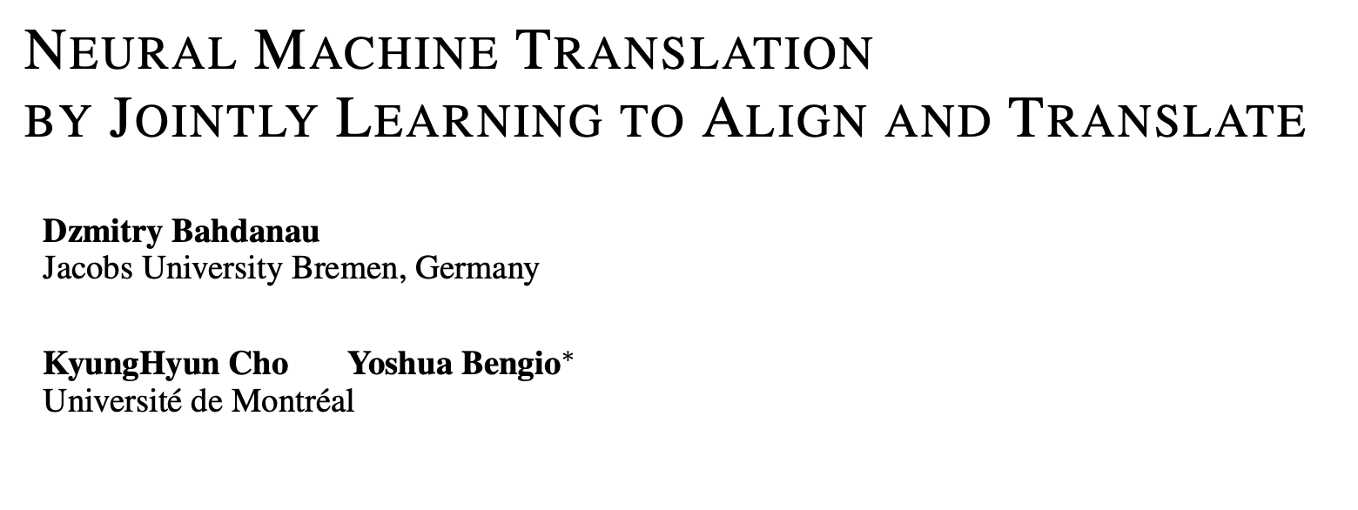
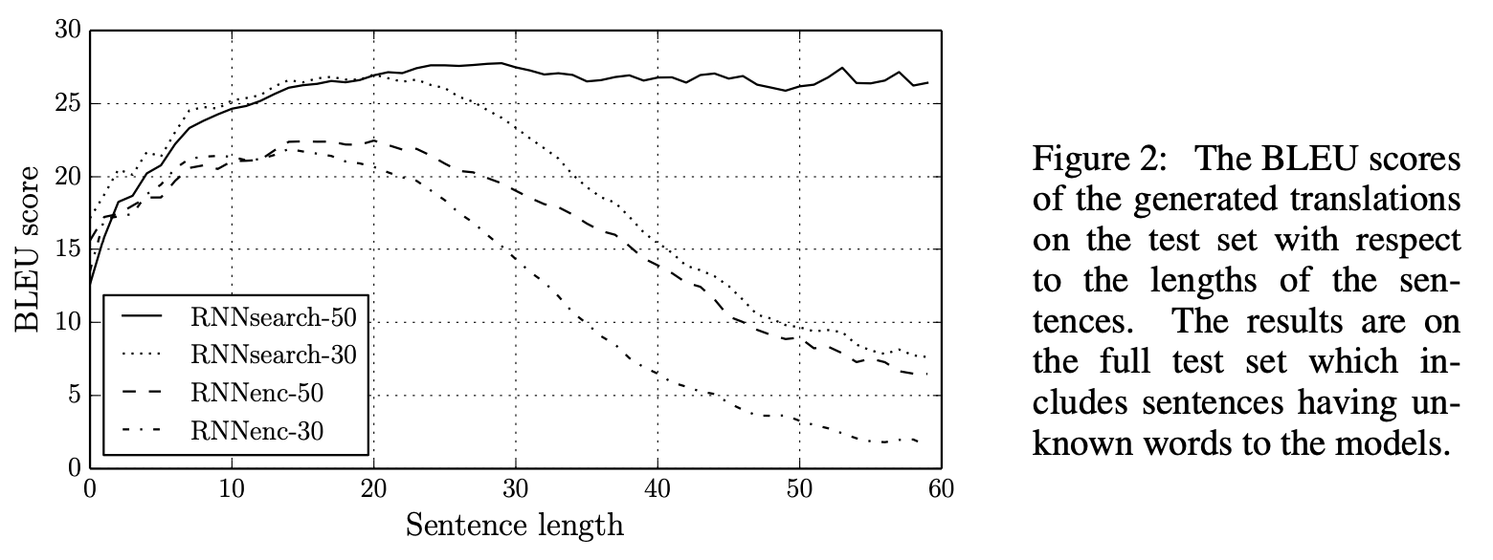
The First (RNN) Attention Model
“ … allowing a model to automatically (soft-)search for parts of a source sentence that are relevant to predicting a target word …”
Notes:
The challenge here in seq2seq models is to compress all of the input information into a single hidden state, to then enable output generation.

Slide 8
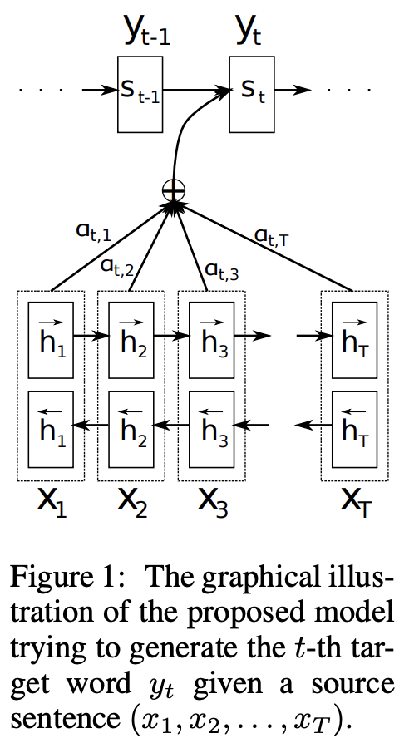
The First (RNN) Attention Model
Two RNNs
A bidirectional RNN handling the input sentence (encoder).
A regular RNN handling the output (decoder).
Two RNNs
Bidirectional RNN reads sentence in both directions.
Produces a hidden state output for each token of input.
Attention weights are calculated too, per token, based on the entire input sequence.
Finally, the attention-weighted output for each token is passed into the regular RNN (which does the final translation).
Each output from that last RNN is based on attention-weighted input token and output hidden state of last translated token (i.e., s_t-1)
Notes:
Novel idea.. we’ll have an RNN processing the input and yielding attention weights / context vector, which will be provided in tandem with memory from regular sequence processing by an RNN, to help the model gain access to all sequence information at the time it makes a prediction.

Slide 9
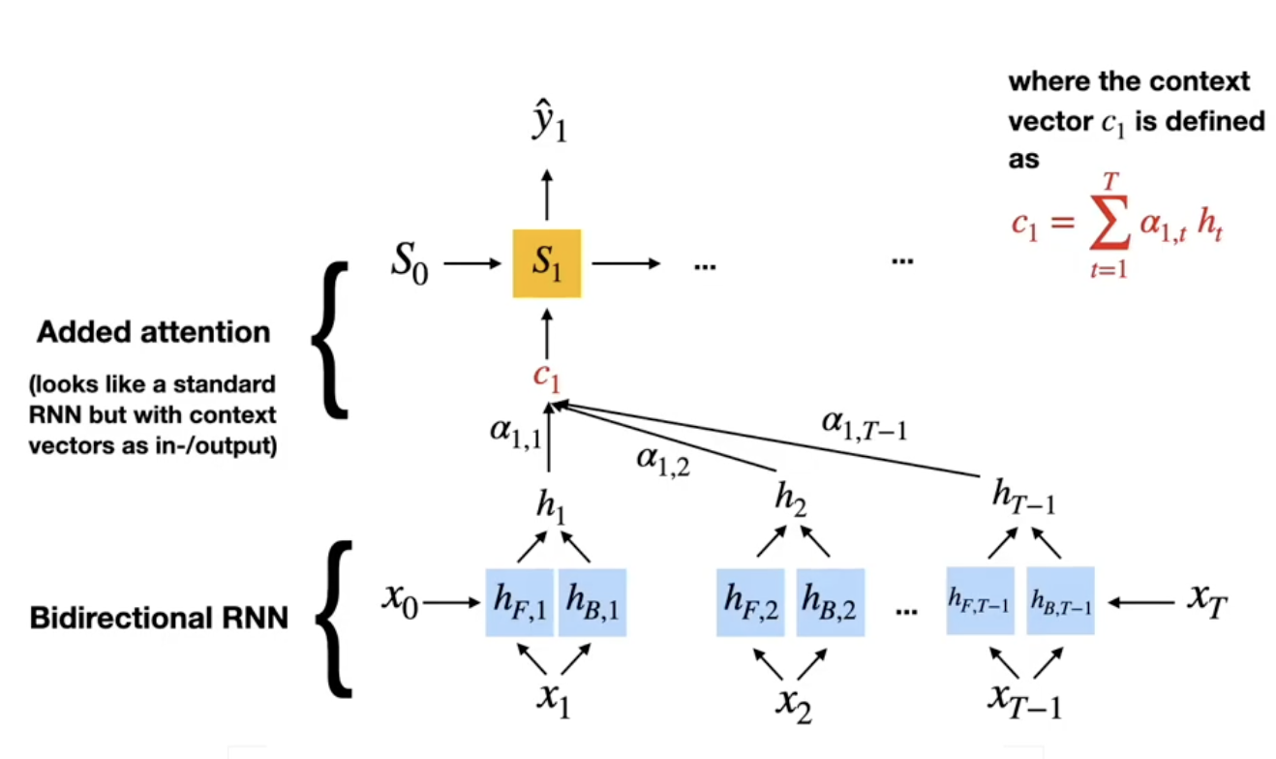
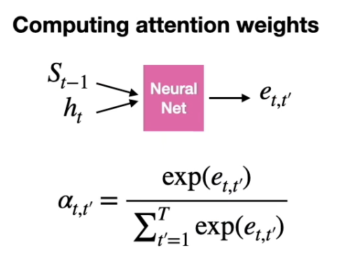
The First (RNN) Attention Model
Notes:
The hidden state from the forward moving RNN e.g., h_f1, is concatenated with the hidden state for that same token from the backward moving RNN, e.g., h_b1.

Slide 10
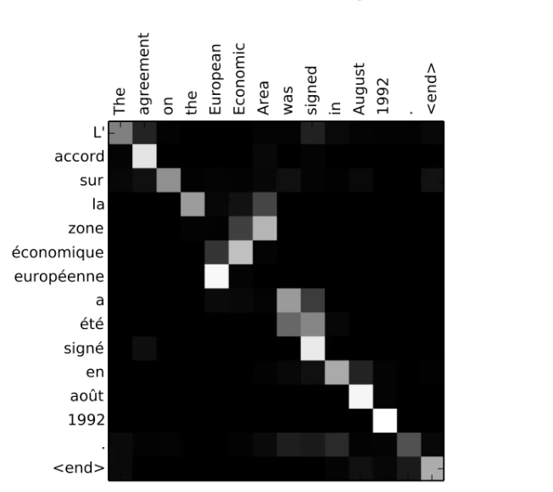
The First (RNN) Attention Model
Notes:
Strong diagonal alone means one-to-one translation of terms works okay, but in several cases we see that the the model pays attention to many other words when deciding how to translate a term… for example, when translating L’ it looks at both “The” and “signed” and “agreement.”

Slide 11
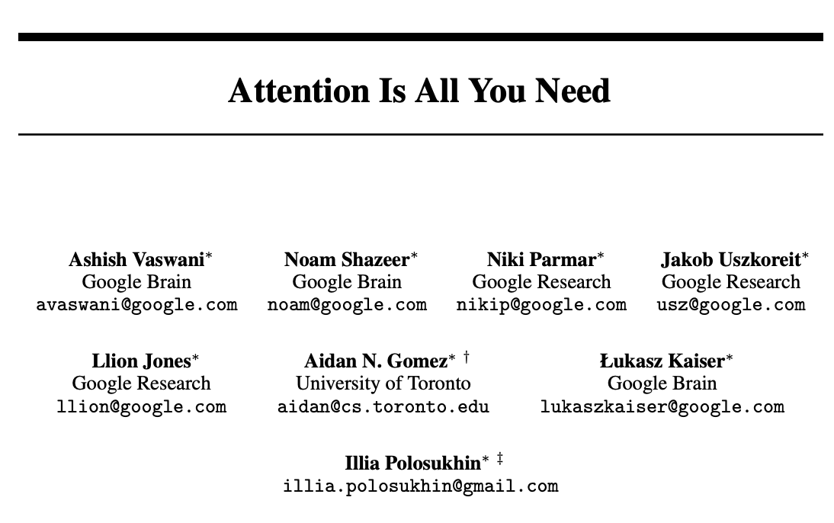
We Don’t Need an RNN to Do This
We Can Drop the RNN and Process the Whole Sequence in Parallel
Note that transformers work with a similar autoencoder architecture, but no LSTMs needed (we use ”stacked attention layers”).
Transformers are actually more computationally expensive (more calculations required), but because we can parallelize them they can be trained faster than RNNs.
By moving away from RNN specific implementation we can also think about more general forms of attention (e.g.,. For CNNs).

Slide 12
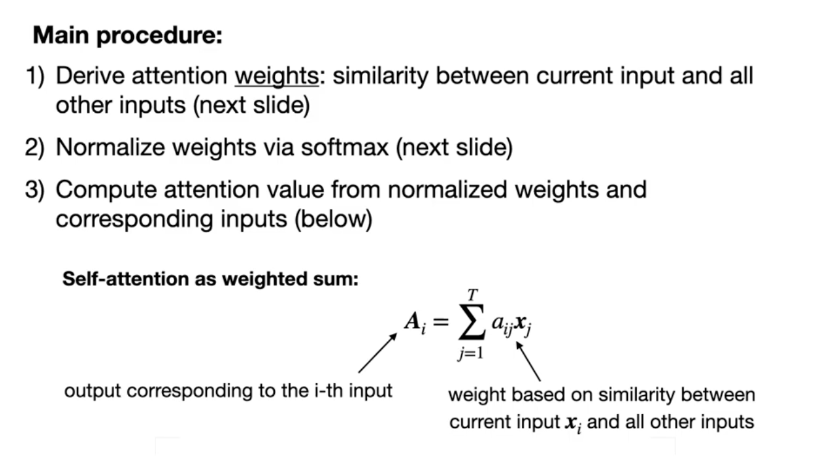
A Simpler Attention Mechanism
Notes:
Here, A for word i is a weighted sum of all words in the sequence, indexed by j. The weights are based on how similar each other word in the sequence is to word i (e.g., based on dot-product). If we find that word I is very semantically similar to many other words in the sequence, we are going to give it a big A (it matters more). If word i is not related to all the other words, we give it a low A.

Slide 13
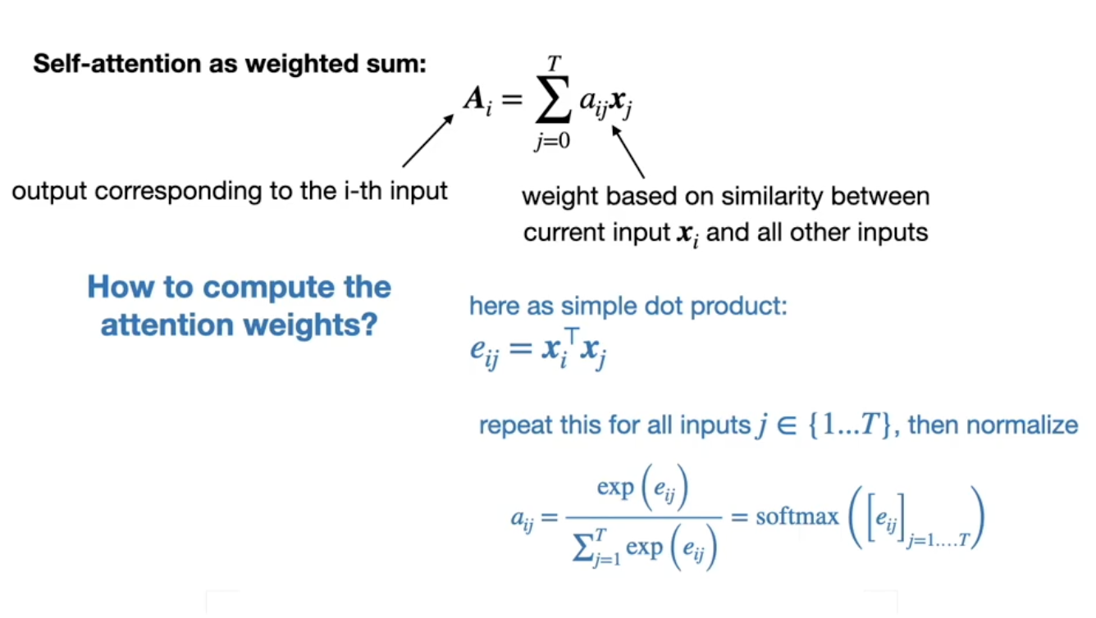
A Simple Attention Mechanism
Notes:
Here, A for word i is a weighted sum of all words in the sequence, indexed by j. The weights are based on how similar each other word in the sequence is to word i (e.g., based on dot-product). If we find that word I is very semantically similar to many other words in the sequence, we are going to give it a big A (it matters more). If word i is not related to all the other words, we give it a low A.
For word i, we take all pairs with other words, j, and calculate their dot products (e). We then softmax the resulting vector of dot product values. This forces the weights to sum to 1, and all lie between 0 and 1.
Once we have the a_ij reflecting word i’s association to each other word, we can now multiply the weights by each word in the sequence and add them up to get big A (roughly interpreted as the importance of word i, or how much attention we should pay to word i.

Slide 14
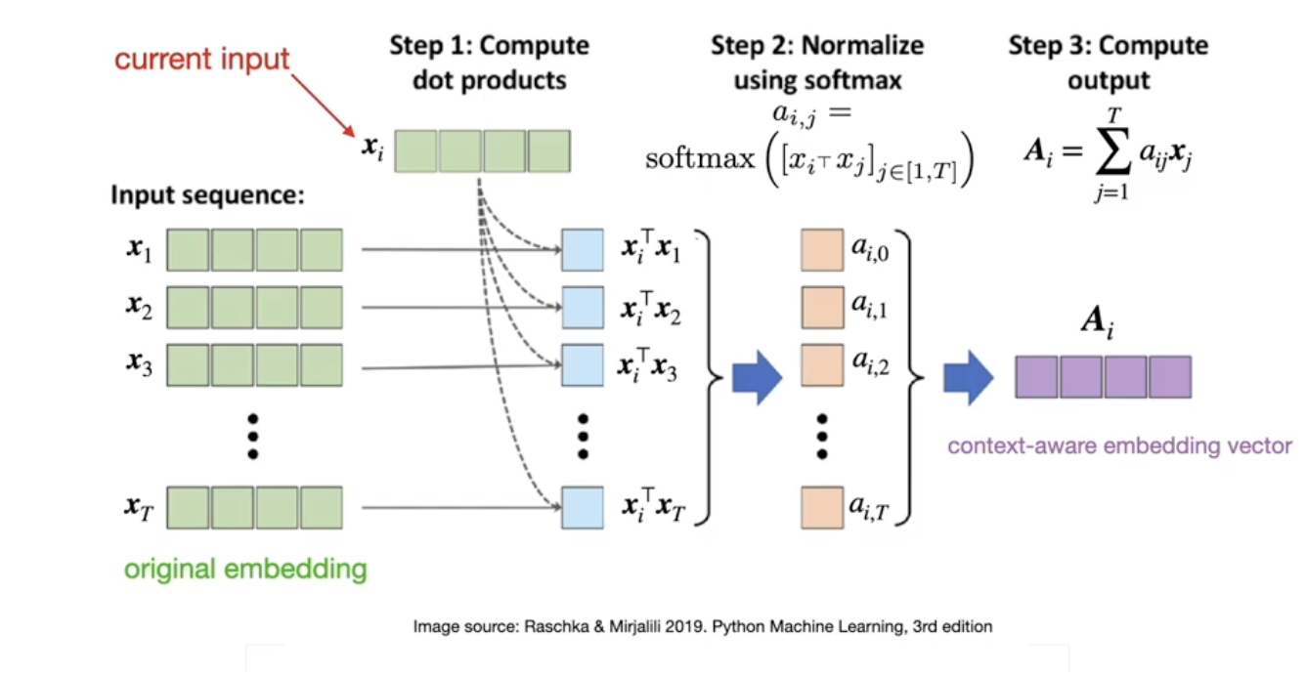
A Simple Attention Mechanism
Notes:
Basically, what we end up with is a vector of A values (one for each input), which we use to predict outputs. You can think about this as replacing term x_i with a context-aware version of x_i. It’s like, forget about x_i, let’s think about an embedding which is a combination of all the words in the sequence (including term x_i) that collectively relate to the concept that word x_i captures. We are looking over the entire input set and adjusting each input token based on what is happening elsewhere in the input set that is relevant to the input token.
Some notes…
x_i is a vector (embedding).
x_i dot x_j is a scalar
a_i,j is the softmax of those various dot products, and each output is again a scalar.
A_i = sumprod(a_i,j and x_j) which is a vector because we sum over only one axis (if we have an 8D embedding to start, we sum over the 8 Ds, and get an 8D context-adjusted embedding.
for x_i we are left with one A_i (the adjusted version of x_i.

Slide 15
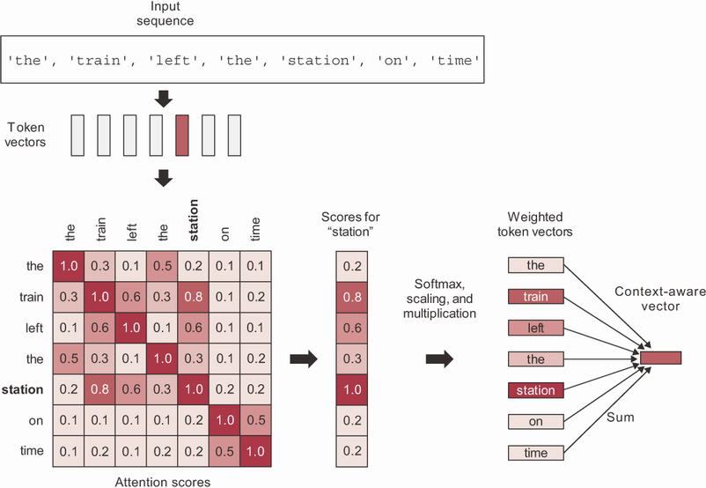
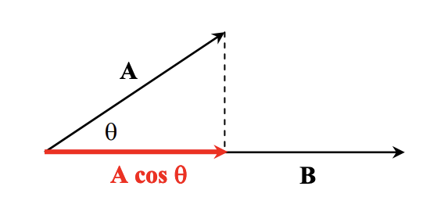
A Basic Self-Attention Mechanism
Most Basic Form of Self-Attention
This is what the textbook introduces.
We magnify vector representations of tokens based on how parallel (semantically related) they are to the other tokens in the input sequence.

Slide 16
The Basic Attention Mechanism is Rigid
The Approach Considers the Input Context in a Very ‘Fixed’ Manner
We get context-specific attention weights, but the notion of context is pre-defined / hard-coded in the dot-product-summation procedure.
The pre-defined approach to attention does not generalize outside of language.
The pre-defined approach to attention assumes that shared semantic similarity is the best heuristic for attention, but perhaps it is not in some cases. Most obviously, perhaps in some scenarios it is ideal to focus attention on words that are semantically dissimilar.
How can we enable a procedure of this sort, but using trainable parameters, so the network can figure out how to allocate attention by itself?

Slide 17
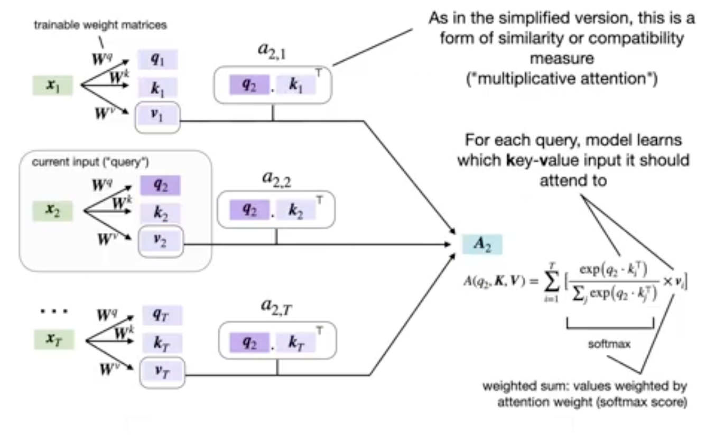
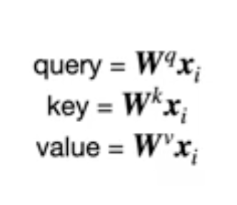
Scaled Dot-Product Attention Mechanism
Notes:
Query, Key and Value comes from the idea of a database lookup.
Query, Key and Value are all weight-matrix multiplied versions of the original input sequence (of embeddings). Thus, rather than use the raw embedding and take its dot product with other raw embeddings, now we have trainable parameters that first apply possibly different transformations to the input embedding of the focal token, to the embeddings of the other tokens in the context, and we then incorporate the eventual attention-modified contextual embedding multiplicatively, with yet another weighted version of the original input embedding. The process is essentially the same as scaled dot-product, but now we have a whole bunch of trainable parameters that let us play with *what* we take the dot products of, and with how we integrate the the attention-weighted information into our prediction.

Slide 18

Flexible Contextual Attention Mechanism
Scaled Dot-Product Attention…
One other nuance is that we scale the Softmax output.
This is done to prevent the output being too close to 1 or too close to 0, which can lead to vanishing gradient issues.
Here, sqrt(d_k) is square root of the dimensionality of the keys (in the original paper this is the same as the dimension of the word embeddings).
We write this in big-letter notation because we can parallelize everything as very large matrix / tensor calculations.
Notes:
Query, Key and Value comes from the idea of a database lookup.
Query, Key and Value are all weight-matrix multiplied versions of the original input sequence (of embeddings). Thus, rather than use the raw embedding and take its dot product with other raw embeddings, now we have trainable parameters that first apply possibly different transformations to the input embedding of the focal token, to the embeddings of the other tokens in the context, and we then incorporate the eventual attention-modified contextual embedding multiplicatively, with yet another weighted version of the original input embedding. The process is essentially the same as scaled dot-product, but now we have a whole bunch of trainable parameters that let us play with *what* we take the dot products of, and with how we integrate the the attention-weighted information into our prediction.

Slide 19
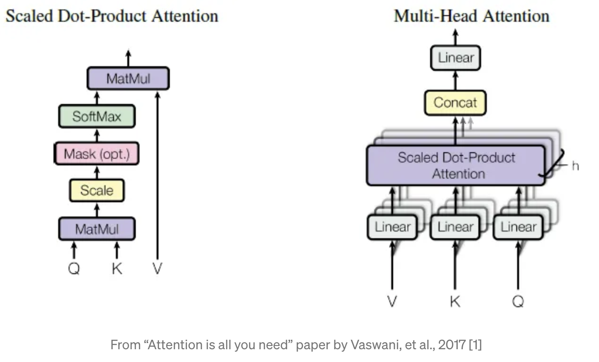
Multi-Head Attention
We have Multiple ‘Heads’ Paying Attention
Each head can be thinking about something very different.
By using multiple sets of query, key and value weight matrices, the network can learn to consider different combinations of input features.
This lets it capture more complex patterns in the data.

Slide 20
Questions?
Notes:
Weights are not initialized until you “build” the model (or compile it, which will first build).

